Slide 1
GUI
A graphical user interface (GUI) presents a pictorial interface to a program.
A GUI gives a program a distinctive “look” add “feel”.
GUI provides programs a set of user interface (UI) components.
GUIs are built from GUI components (also called controls).
A GUI component is an object with which the user interacts via the mouse, the keyboard or another form of input.

Slide 2
Swing
The classes that create the GUI components are part of the Swing GUI components from package javax.swing.
Most Swing components are written, manipulated and displayed completely in Java (so-called pure Java components).
The Swing components allow the programmer to specify a uniform look and feel across all platforms.
Swing components are often referred to as lightweight components since they are completely written in Java.

Slide 3
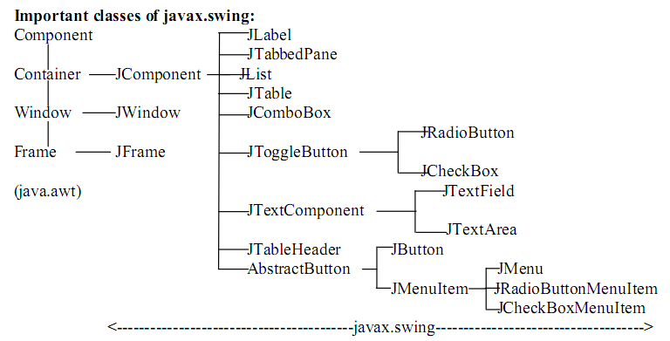
Swing Component Hierarchy

Slide 4
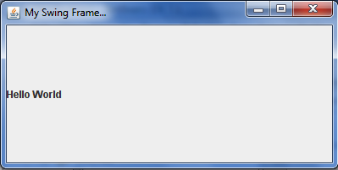
Example: import javax.swing.*; public class SwingTest { public .. main(…) { JFrame jf = new JFrame("My Swing Frame..."); jf.setSize (400,200); jf.setVisible (true); JLabel label = new JLabel("Hello World"); jf.getContentPane().add(label); jf.setDefaultCloseOperation (JFrame.EXIT_ON_CLOSE); } }

